Slide 1
MAP SYNTH
"GIS-BASED INTERACTIVE GLOBAL INFORMATION PLATFORM FOR ENHANCING NAVIGATION AND DATA VISUALIZATION"
Group ID: PCSE25-35
Guide: Prof. Bharti
PROJECT OUTCOMES
SUTAINABLE DEVELOPMENT GOALS
SDG 1: Industry, Innovation, and Infrastructure
This project introduces an innovative offline-capable GIS platform using open-source technologies, empowering remote areas and supporting smart mobility infrastructure.
SDG 2: Sustainable Cities and Communities
GIP enhances urban and rural mobility through adaptive navigation, real-time location sharing, and travelogues, making communities smarter and more connected.
SDG 3: Climate Action
By supporting eco-friendly travel planning and offline functionality, GIP reduces data dependency and encourages sustainable practices in navigation and transportation.
Engineering knowledge
Problem analysis
Design/development of solutions
Modern tool usage
Environment and sustainability
Lifelong learning
Team Members:
Mansi Verma
Parvendra Singh
Rajat Tevatia
Rishabh Chaudhary

Slide 2
INTRODUCTION
PROBLEM STATEMENT
PROPOSED SOLUTION
Digital mapping technologies like Google Maps have transformed how we navigate and access location information. However, they face significant challenges such as limited personalization, poor offline functionality in areas with weak connectivity, and ethical concerns surrounding user privacy and the accuracy of crowdsourced data. These limitations highlight the need for more adaptive and trustworthy mapping solutions. The Geographic Information Systems (GIS) community is actively exploring ways to enhance data reliability, user privacy, and offline access to better meet diverse and evolving user needs.
To address these challenges, the Interactive Global Information Platform (GIP), called MapSynth, offers a next-generation digital mapping solution. It features adaptive navigation tailored to user preferences, downloadable offline maps for reliable use without internet, real-time location sharing with strong privacy safeguards, and AI-powered data moderation to ensure accuracy. Additionally, GIP supports vehicle-specific routing, community-driven updates, and dynamic geographic modeling to respond to changing environments. Together, these features aim to provide a more personalized, trustworthy, and socially responsible mapping experience.

Slide 3
Goals of GIP (MapSynth)
Make navigation easy and personal for each user
Let people use maps even without internet
Keep user location private and safe
Give routes based on the type of vehicle
Let the community help update the maps
Adjust maps to changes in the environment

Slide 4

LITERATURE SURVEY
🔹 Challenges in Current Digital Mapping Systems
Subjective Data Limitations: Traditional platforms like Google Maps rely on static algorithms, ignoring dynamic user needs (e.g., wheelchair access, neurodiverse routes) (Zheng et al., 2011).
Biased Crowdsourcing: Crowdsourced data often underrepresents rural areas and lacks ethical safeguards (Elwood et al., 2012).
🔹 Advanced Technologies in Modern GIS
Machine Learning (ML) Routing: Adapts routes using real-time traffic, weather, and user preferences (Zheng et al., 2011).
AI Moderation: Filters biased/inaccurate crowdsourced data via NLP and community voting (Haklay, 2010).
🔹 Key Studies & Innovations
Sui & Goodchild (2011): Showed convergence of GIS and social media but lacked privacy frameworks.
Gao et al. (2017): Built Hadoop-based gazetteers for big geodata but omitted offline usability.

Slide 5
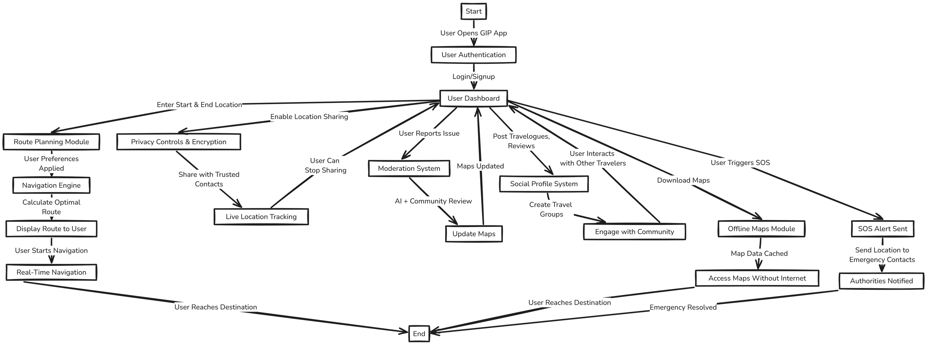
USER FLOWCHART

Slide 6
CONCLUSION
Key Findings
GIP solves problems like no internet, wrong directions, and privacy issues.
It gives smart, safe, and personalized routes.
By using community updates, it builds trust and keeps the map up to date.
2. Challenges & Limitations
User-added data must be checked for mistakes.
Offline maps need regular updates.
Some users may need help learning the new features.

Slide 7
FUTURE DIRECTIONS
User Testing & Feedback: Try GIP with real users to improve features and fix any issues.
Smarter AI Models: Make AI faster and better at checking and updating map data.
More Offline Features: Add full offline support, including search and navigation.
Mobile App Launch: Build and release a GIP mobile app for Android and iOS.
More Local Data: Work with local people and authorities to get better, area-specific information.
Advanced Privacy Options: Add more user control over who can see their location.
Extra Features: Add real-time weather, traffic alerts, and SOS emergency tools.

Slide 8

THANK YOU

